Slide 1
Python – Relational Database

Slide 2


Slide 3

30 Days Python Master Class
Day1 : Python
Time: 6.00 PM IST
Free Registration

Slide 4
Python Master Class
Handbook

Slide 5
NANDHINI.S
Exp: 5 Yrs
Expert in
Python Developer on Machine Learning
Deep learning with computer vision
Matlab – Image Processing
Autonomous Car design using ROS with LIDAR
Language – Python , Java , HTML ,CSS.
Tools – ANACONDA NAVIGATOR, JUPYTER NOTEBOOK,
GOOGLE COLAB.
Graduation : BE – ECE | 2011

Slide 6
Pantech?
Educational Equipment Manufacturer
IoT, AI, Robotics,Autonomous Robot
Microprocessor/Microcontroller
DSP,VLSI, Embedded System
Power Electronics & Drives, Fuel Cell Trainer Kit
Renewable Energy Lab, Electric Vehicle Lab
Technical Training
DIY Project

Slide 7

What is Master Class ?
👍 This is the 30 Days Industrial Learning Activity.
👍 Its Online YouTube Live Class
👍 If you Invest 45 minutes daily, U will become Master in Data Science
👍 You will get FREE E-Certificate
Webinar Participation Certificate
“Learning is the beginning of wealth.
Searching & Learning is where the miracle process all begins.” …………….Jim Rohn

Slide 8
Our Vision
Help 10 Million Students to Learn the Technology in Easy Way

Slide 9

Associate Partner for this Master Class
https://apssdc.in/home/

Slide 10
What U will Learn from 30 Days Data Science & Analytics Master Class

Slide 11
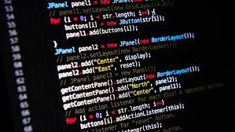
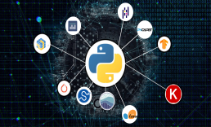


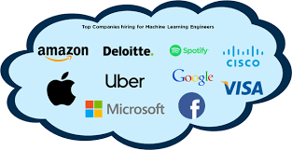
Python Learning Plan
01
02
03
04
05
Library
Python
Analytics
Analytics
Industry Project
Introduction To Python and Python Data Structures
Pandas
Numpy
MatplotLib
Cborn, SKLearn Lib
Collab
Distribution
Visualization
Aggregation
Statistics
Distribution Function
Project Building

Slide 12
Day wise Learning Plan
Day -1 : Introduction to Python
Day -2: Python – Tools|Syntaxes & Data Structures
Day -3: Python – Dictionaries,Date and Time
Day -4: Python – MySql
Day -5: Pandas library – Introduction
Day -6: Pandas library – Data Structures
Day -7: Numpy library – Introduction
Day -8: Numpy library – Array Manipulations, Mathematical Functions
Day -9: Matplotlib , Histogram Using Matplotlib | I/O With Numpy
Day -10: Matplotlib Library - Introduction , Pyplot API | Types Of Plots
Day -11: Seaborn Library
Day -12: SKLearn Library
Day -13: Python – Date and Time , Data Wrangling.
Day -14: Python – Data Cleansing
Day -15: Python – Word Tokenization , Stemming and Lammetization.

Slide 13
Day wise Learning Plan
Day -16: Python – Data Visualization
Day -17: Python – Statistical Analysis
Day -18: Python – Types Of Distribution
Day -19: Python – Correlation ,Chi-Square Test , Linear Regression
Day -20: Keras library – Introduction.
Day -21: Stock Price Prediction With Machine Learning LSTM RNN
Day -22: People’s behaviour in chat message using NLP NLP
Day -23: Gaming In Python
Day -24: Chatbot creation in Python NLP
Day -25: Electricity Price Prediction Using ML Random Forest Regressor
Day -26: Diamond Price Prediction Using Python Linear Regression
Day -27: Book Recommendation System KNN
Day -28: Image Classification Using CNN CNN
Day -29: Titanic Survival Analysis Using ML Logistic Regression
Day -30: Blockchain in Python

Slide 14
List of Projects for Demo in YouTube Live
Stock Price Prediction With Machine Learning
People’s behaviour in chat message using NLP
Gaming In Python
Chatbot creation in Python
Electricity Price Prediction Using ML
Diamond Price Prediction Using Python
Book Recommendation System
Image Classification Using CNN
Titanic Survival Analysis Using ML
Blockchain in Python
All Projects in Jupyter Notebook

Slide 15
What you will get from this Free 30 Days Master Class?
You can attend YouTube Live Class
Free E-Certificate ( WEBINAR PARTICIPATION CERTIFICATE)

Slide 16
How to mark your Attendance in YouTube Live Class?
Ans : During the Live Class, organizer will post Google Form link in Live Chat. The Participants should submit the from on daily basis. Minimum 25 Days Attendance is Required to get Free Master Class Participation Certificate.
Note : The Link will be available during the Live. From the LIVE Class date, the live video will get removed from the YouTube in 3 days.

Slide 17
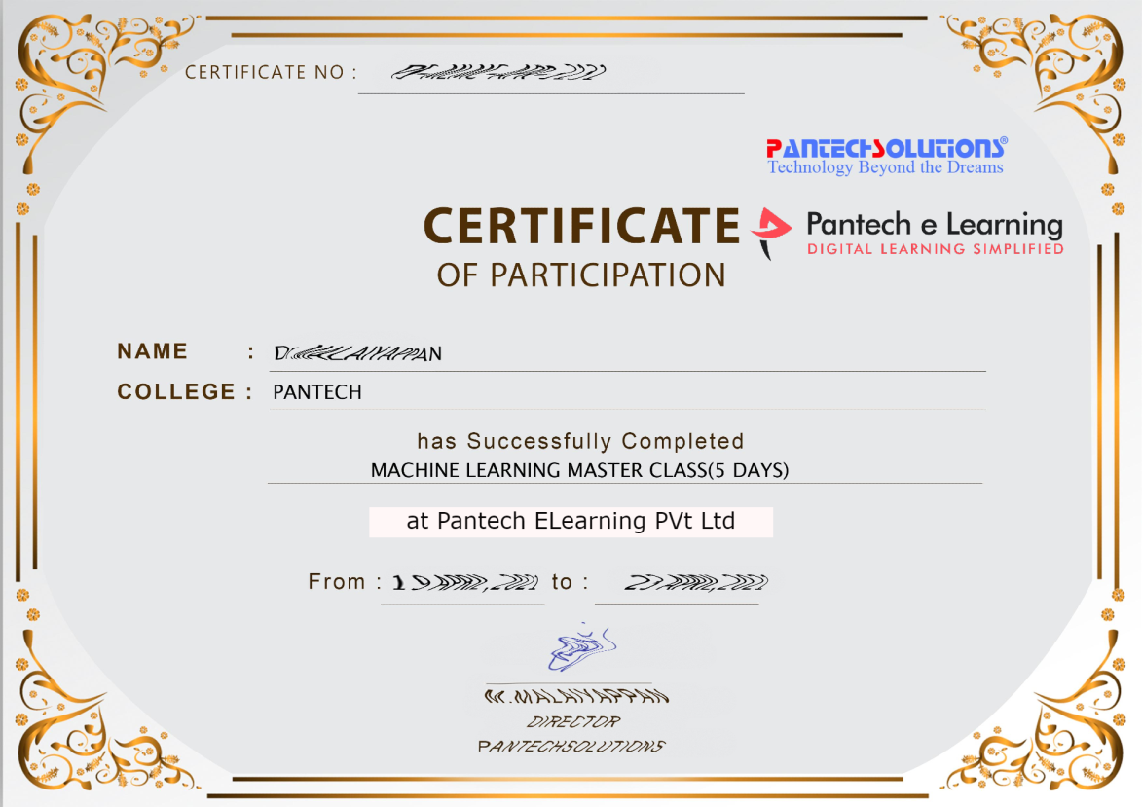

Sample Webinar Participation Certificate?

Slide 18
https://www.pantechelearning.com/data-science-master-class/
On Demand
You can get chance to apply 1 Month Internship on Data Science & Analytics Master Class

Slide 19
What is Internship????
Learn
Practice
Verify
Get Certified
Grow

Slide 20
Free Master Class DSA | 1 Month Internship on DSA
Master Class Participation Certificate | Internship Completion Certificate
Minimum 25 Class should attend YouTube Live | Recorded Class Link will be provided. – LMS Portal Access
YouTube Live Mandatory | Your Choice. You can attend Live or else You can watch Recorded Class in LMS Portal
All Projects Demo class in YouTube Live | Step by Step Video Explanation Content in LMS Portal
Access : 3 Days | VIP WhatsApp Group Support
 | You Can Download All PPTs
 | 4 Nos of Hackathon Class in Zoom Live. The Recording also will be provided
 | You Can Download All Project Files
 | Mentor will guide you to finish 10 Projects
 | Access : 60 Days

Slide 21
Pantech will make you to Create 10 Projects in Data Science & Analytics in 30 Days
Objective of this 30 Days Master Class

Slide 22
1 Month Internship in Data Science
INTERNSHIP E-Certificate(30Days Internship on Data Science Engineering)
Highly organized Video content
Download All Files
Download PPTs
Assignments
Flexible Time.
Access Period: 60Days from the date of payment

Slide 23
What You Will Get???
Complete Project Files
30 Days Learning Activity
Data Science Core Concepts
10 + Projects
Project PPT
Spatial Data Science For Covid-19 Disease Prediction
Parkinson’s Disease Prediction-XGBoost Classifier
House Price Prediction-Random Forest Regression
Customer Segmentation Using ML-K-Means Clustering
Home Loan Prediction-Decision Tree Classifier
Spam Classification-NLP
Hand Written Digit Recognition Using Python-CNN
Churn Prediction-Deep Learning
Crop Yield Prediction
Ground water level prediction
Video Class Access for 2 Months
Get chance to Enroll 1-Month Internship on demand

Slide 24
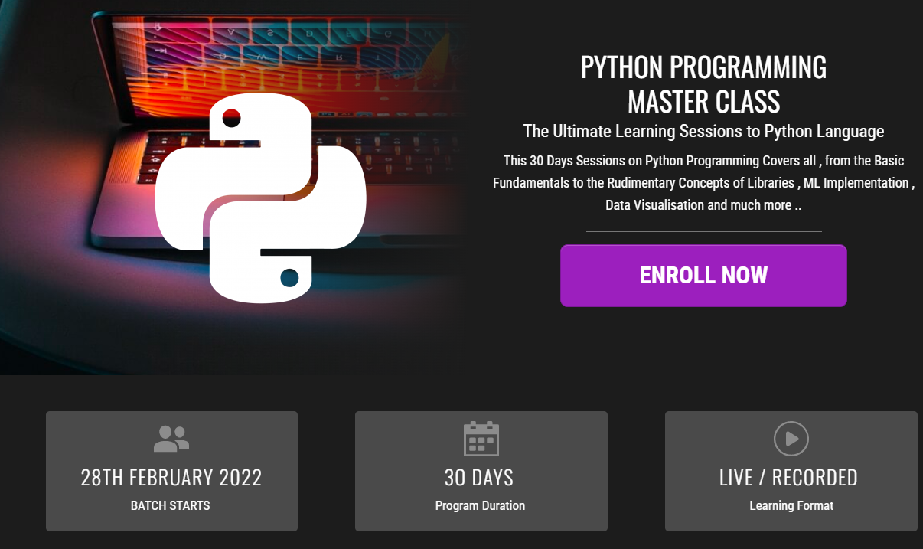
How to join in 1 month Internship
https://www.pantechelearning.com/pymc-internship/
Coupon Code: PYMC

Slide 25
30 Days Data Scinece & Analytics Master Class
Day1 : Python for Data Science
Time: 6.00 PM IST
Free Registration

Slide 26
30 Days Data Scinece & Analytics Master Class
Handbook

Slide 27
NANDHINI.S
Exp: 5 Yrs
Expert in
Python Developer on Machine Learning
Deep learning with computer vision
Matlab – Image Processing
Autonomous Car design using ROS with LIDAR
Language – Python , Java , HTML ,CSS.
Tools – ANACONDA NAVIGATOR, JUPYTER NOTEBOOK,
GOOGLE COLAB.
Graduation : BE – ECE | 2011

Slide 28
Pantech?
Educational Equipment Manufacturer
IoT, AI, Robotics,Autonomous Robot
Microprocessor/Microcontroller
DSP,VLSI, Embedded System
Power Electronics & Drives, Fuel Cell Trainer Kit
Renewable Energy Lab, Electric Vehicle Lab
Technical Training
DIY Project

Slide 29
What is Master Class ?
👍 This is the 30 Days Industrial Learning Activity.
👍 Its Online YouTube Live Class
👍 If you Invest 45 minutes daily, U will become Master in Data Science
👍 You will get FREE E-Certificate
Webinar Participation Certificate
“Learning is the beginning of wealth.
Searching & Learning is where the miracle process all begins.” …………….Jim Rohn

Slide 30
Our Vision
Help 10 Million Students to Learn the Technology in Easy Way

Slide 31
Associate Partner for this Master Class
https://apssdc.in/home/

Slide 32
What U will Learn from 30 Days Data Science & Analytics Master Class

Slide 33
Data Science & Analytics Learning Plan
01
02
03
04
05
Library
Python
Analytics
Tools
Industry Project
Introduction To Python and Python Data Structures
Pandas
Numpy
MatplotLib
Cborn, SKLearn Lib
Collab
Distribution
Visualization
Aggregation
Statistics
PowerBi
Tableo
Project Building,
DSA Jobs

Slide 34
Day wise Learning Plan
Day -1 : Python for Data Science (5 Solved end-to-end Data Science Projects in Python)
Day -2: Advanced Python Programming
Day -3: Pandas Library – Introduction
Day -4: Pandas Library – Data Structures
Day -5: Numpy library – Array Operations | Mathematical Functions
Day -6: Numpy – Sort, Search and Counting Functions
Day -7: Matplotlib , Histogram Using Matplotlib | I/O With Numpy
Day -8: Matplotlib Library – Introduction , Pyplot API | Types Of Plots
Day -9: Seaborn Library
Day -10: SKLearn Library
Day -11: Google Colab Notebook
Day -12: Python – Date and Time, Data Wrangling
Day -13: Python – Data Aggregation
Day -14: Python – Word Tokenization , Stemming and Lammetization
Day -15: Python – Data Visualization

Slide 35
Day wise Learning Plan
Day -16: Python – Statistical Analysis
Day -17: Python – Types Of Distribution
Day -18: Python – Correlation ,Chi-Square Test , Linear Regression
Day -19: Tableau – Introduction and Tools
Day -20: Tableau – Data Sources , Worksheets
Day -21: Spatial Data Science For Covid-19 Disease Prediction
Day -22: Power-BI – Introduction, Installation Steps and Architecture
Day -23: Power-BI – Data Modelling , Visualization Options | Excel Integration
Day -24: Parkinson’s Disease Prediction – XG Boost Classifier
Day -25: House Price Prediction using Random Forest Regression
Day -26: Customer Segmentation Using ML – K-Means Clustering
Day -27: Home Loan Prediction using Decision Tree Classifier
Day -28: Spam Classification using NLP
Day -29: Hand Written Digit Recognition Using CNN
Day -30: Churn Prediction using Deep Learning

Slide 36
List of Projects for Demo in YouTube Live
Spatial Data Science For Covid-19 Disease Prediction
Parkinson’s Disease Prediction-XGBoost Classifier
House Price Prediction-Random Forest Regression
Customer Segmentation Using ML-K-Means Clustering
Home Loan Prediction-Decision Tree Classifier
Spam Classification-NLP
Hand Written Digit Recognition Using Python-CNN
Churn Prediction-Deep Learning
Crop Yield Prediction
Ground water level prediction
All Projects in Jupyter Notebook

Slide 37
What you will get from this Free 30 Days Master Class?
You can attend YouTube Live Class
Free E-Certificate ( WEBINAR PARTICIPATION CERTIFICATE)

Slide 38
How to mark your Attendance in YouTube Live Class?
Ans : During the Live Class, organizer will post Google Form link in Live Chat. The Participants should submit the from on daily basis. Minimum 25 Days Attendance is Required to get Free Master Class Participation Certificate.
Note : The Link will be available during the Live. From the LIVE Class date, the live video will get removed from the YouTube in 3 days.

Slide 39
Sample Webinar Participation Certificate?

Slide 40
https://www.pantechelearning.com/data-science-master-class/
On Demand
You can get chance to apply 1 Month Internship on Data Science & Analytics Master Class

Slide 41
What is Internship????
Learn
Practice
Verify
Get Certified
Grow

Slide 42
Free Master Class DSA | 1 Month Internship on DSA
Master Class Participation Certificate | Internship Completion Certificate
Minimum 25 Class should attend YouTube Live | Recorded Class Link will be provided. – LMS Portal Access
YouTube Live Mandatory | Your Choice. You can attend Live or else You can watch Recorded Class in LMS Portal
All Projects Demo class in YouTube Live | Step by Step Video Explanation Content in LMS Portal
Access : 3 Days | VIP WhatsApp Group Support
 | You Can Download All PPTs
 | 4 Nos of Hackathon Class in Zoom Live. The Recording also will be provided
 | You Can Download All Project Files
 | Mentor will guide you to finish 10 Projects
 | Access : 60 Days

Slide 43
Pantech will make you to Create 10 Projects in Data Science & Analytics in 30 Days
Objective of this 30 Days Master Class

Slide 44
1 Month Internship in Data Science
INTERNSHIP E-Certificate(30Days Internship on Data Science Engineering)
Highly organized Video content
Download All Files
Download PPTs
Assignments
Flexible Time.
Access Period: 60Days from the date of payment

Slide 45
What You Will Get???
Complete Project Files
30 Days Learning Activity
Data Science Core Concepts
10 + Projects
Project PPT
Spatial Data Science For Covid-19 Disease Prediction
Parkinson’s Disease Prediction-XGBoost Classifier
House Price Prediction-Random Forest Regression
Customer Segmentation Using ML-K-Means Clustering
Home Loan Prediction-Decision Tree Classifier
Spam Classification-NLP
Hand Written Digit Recognition Using Python-CNN
Churn Prediction-Deep Learning
Crop Yield Prediction
Ground water level prediction
Video Class Access for 2 Months
Get chance to Enroll 1-Month Internship on demand

Slide 46
How to join in 1 month Internship
https://www.pantechelearning.com/pymc-internship/
Coupon Code: PYMC

Slide 47
Python – Database Connection
A connection can be made to connect to other relational databases using the pandas library.
Other additional libraries can also be used for implementing database connectivity.
SQLAlchemy is a package which provides full sql functionality to be used in python.

Slide 48
SQLAlchemy Installation
Pip install sqlalchemy.

Slide 49
Reading Relational Tables
Sqlite3 is used as a relational database,
It is a very light weight and easy to use database.
SQLAlchemy can connect to a variety of relational sources like MySql , Oracle and Postgresql.
Create a database engine and connect to the database engine to_sql function of the SQLAlchemy library.

Slide 50
Reading Relational Tables
Create a relational table using the to_sql function.
Use the read_sql_query function from the pandas library to execute and capture queries from various SQL queries.

Slide 51
Reading Relational Tables - Examples
from sqlalchemy import create_engine
import pandas as pd
data = pd.read_csv('/path/input.csv')
# Create the db engine
engine = create_engine('sqlite:///:memory:')
# Store the dataframe as a table
data.to_sql('data_table', engine)

Slide 52
Reading Relational Tables - Examples
# Query 1 on the relational table
res1 = pd.read_sql_query('SELECT * FROM data_table', engine) print('Result 1')
print(res1)
print('')
# Query 2 on the relational table
res2 = pd.read_sql_query('SELECT dept,sum(salary) FROM data_table group by dept', engine)
print('Result 2')
print(res2)

Slide 53
Reading Relational Tables - Output
Result 1
index id name salary start_date dept
0 0 1 Rick 623.30 2012-01-01 IT
1 1 2 Dan 515.20 2013-09-23 Operations
2 2 3 Tusar 611.00 2014-11-15 IT
3 3 4 Ryan 729.00 2014-05-11 HR
4 4 5 Gary 843.25 2015-03-27 Finance
5 5 6 Rasmi 578.00 2013-05-21 IT
6 6 7 Pranab 632.80 2013-07-30 Operations
7 7 8 Guru 722.50 2014-06-17 Finance

Slide 54
Reading Relational Tables - Output
Result 2
dept sum(salary)
0 Finance 1565.75
1 HR 729.00
2 IT 1812.30
3 Operations 1148.00

Slide 55
Inserting Data Into Relational Tables
Data can be inserted into relational tables using sql.execute function available in pandas.
from sqlalchemy import create_engine
from pandas.io import sql
import pandas as pd
data = pd.read_csv('C:/Users/Rasmi/Documents/pydatasci/input.csv') engine = create_engine('sqlite:///:memory:')
# Store the Data in a relational table
data.to_sql('data_table', engine)

Slide 56
Inserting Data Into Relational Tables
# Insert another row
sql.execute('INSERT INTO data_table VALUES(?,?,?,?,?,?)', engine, params=[('id',9,'Ruby',711.20,'2015-03-27','IT')])
# Read from the relational table
res = pd.read_sql_query('SELECT ID,Dept,Name,Salary,start_date FROM data_table', engine)
print(res)

Slide 57
Output
id dept name salary start_date
0 1 IT Rick 623.30 2012-01-01
2 Operations Dan 515.20 2013-09-23
3 IT Tusar 611.00 2014-11-15
4 HR Ryan 729.00 2014-05-11
5 Finance Gary 843.25 2015-03-27
6 IT Rasmi 578.00 2013-05-21
7 Operations Pranab 632.80 2013-07-30
8 Finance Guru 722.50 2014-06-17
9 IT Ruby 711.20 2015-03-27

Slide 58
Deleting Data From Relational Tables
Data can be deleted from related tables using sql.execute function available in pandas.
from sqlalchemy import create_engine
from pandas.io import sql
import pandas as pd
data = pd.read_csv('C:/Users/Rasmi/Documents/pydatasci/input.csv') engine = create_engine('sqlite:///:memory:')

Slide 59
Deleting Data From Relational Tables
data.to_sql('data_table', engine)
sql.execute('Delete from data_table where name = (?) ', engine, params=[('Gary')])
res = pd.read_sql_query('SELECT ID,Dept,Name,Salary,start_date FROM data_table', engine)
print(res)

Slide 60
Output
id dept name salary start_date
0 1 IT Rick 623.3 2012-01-01
2 Operations Dan 515.2 2013-09-23
3 IT Tusar 611.0 2014-11-15
4 HR Ryan 729.0 2014-05-11
6 IT Rasmi 578.0 2013-05-21
7 Operations Pranab 632.8 2013-07-30
8 Finance Guru 722.5 2014-06-17

Slide 61
Python – NoSQL Databases
Data is available in unstructured as well as semi –structured form.
So , the data should be managed through nosql databases.
Python can interact with nosql databases as it interacts with relational databases.
Python is used to interact with MongoDB as a NoSql database.
In order to connect to MongoDB , it uses a library known as pymongo.
Pip is the command to install a particular module.
Pip install pymongo.

Slide 62
PyMongo – Inserting Data
Insert() method is used to insert data into the MongoDB.
Details to be stored in the database are given in the form of key – value pairs.

Slide 63
PyMongo – Inserting Data
# Import the python libraries
from pymongo import MongoClient
from pprint import pprint
# Choose the appropriate client
client = MongoClient()
# Connect to the test db db=client.test
# Use the employee collection
employee = db.employee
employee_details = { 'Name': 'Raj Kumar', 'Address': 'Sears Streer, NZ', 'Age': '42'
}

Slide 64
PyMongo – Inserting Data
# Use the insert method
result = employee.insert_one(employee_details)
# Query for the inserted document.
Queryresult = employee.find_one({'Age': '42'})
pprint(Queryresult)

Slide 65
Output
{u'Address': u'Sears Streer, NZ', u'Age': u'42', u'Name': u'Raj Kumar', u'_id': ObjectId('5adc5a9f84e7cd3940399f93')}

Slide 66
PyMongo – Updating Data
Update() method is used to update the existing records.
The existing record is replaced with new key – value pairs.
A condition criteria is used to decide which record to update.

Slide 67
PyMongo – Deleting Data
Delete() method is used to delete a particular record.
# Import the python libraries
from pymongo import MongoClient
from pprint import pprint
# Choose the appropriate client
client = MongoClient()
# Connect to db
db=client.test
employee = db.employee

Slide 68
PyMongo – Deleting Data
# Use the condition to choose the record
# and use the delete method
db.employee.delete_one({"Age":'35'})
Queryresult = employee.find_one({'Age':'35'})
pprint(Queryresult)

Slide 69
Output
None

Slide 70
Python – Date and Time
In data science , we need analysis which is based on temporal values.
Python can handle various formats of date and time.
The datetime library provides the essential methods and functions.
Date Time Representation
Date Time Arithmetic
Date Time Comparison

Slide 71
Python – Date Time Representation
A date and its various parts are represented by different datetime functions.
Format specifiers are used to display the alphabetical parts of a date like name of the month or week day.

Slide 72
Python – Date Time Representation
import datetime
print ('The Date Today is :', datetime.datetime.today())
date_today = datetime.date.today()
print (date_today)
print ('This Year :', date_today.year)
print ('This Month :', date_today.month)
print ('Month Name:',date_today.strftime('%B'))
print ('This Week Day :', date_today.day)
print ('Week Day Name:',date_today.strftime('%A'))

Slide 73
Date Time Representation - Output
The Date Today is : 2018-04-22 15:38:35.835000
2018-04-22
This Year : 2018
This Month : 4
Month Name: April
This Week Day : 22
Week Day Name: Sunday

Slide 74
Python – Date Time Arithmetic
In order to do various operations related to dates , the dates are stored in different variables.
Then , the relevant mathematical operator are applied to those variables.

Slide 75
Python – Date Time Arithmetic
import datetime
#Capture the First Date
day1 = datetime.date(2018, 2, 12)
print ('day1:', day1.ctime())
# Capture the Second Date
day2 = datetime.date(2017, 8, 18)
print ('day2:', day2.ctime())
# Find the difference between the dates
print ('Number of Days:', day1-day2)

Slide 76
Python – Date Time Arithmetic
date_today = datetime.date.today()
# Create a delta of Four Days
no_of_days = datetime.timedelta(days=4)
# Use Delta for Past Date
before_four_days = date_today - no_of_days
print ('Before Four Days:', before_four_days )
# Use Delta for future Date
after_four_days = date_today + no_of_days
print ('After Four Days:', after_four_days )

Slide 77
Date Time Arithmetic - Output
day1: Mon Feb 12 00:00:00 2018
day2: Fri Aug 18 00:00:00 2017
Number of Days: 178 days, 0:00:00
Before Four Days: 2018-04-18
After Four Days: 2018-04-26

Slide 78
Output
day1: Mon Feb 12 00:00:00 2018
day2: Fri Aug 18 00:00:00 2017
Number of Days: 178 days, 0:00:00
Before Four Days: 2021-12-12
After Four Days: 2021-12-20

Slide 79
Python – Date Time Comparison
Date and time are compared using logical operators.
One must be careful in comparing right parts of the dates with each other.

Slide 80
Date Time Comparison
import datetime
date_today = datetime.date.today()
print ('Today is: ', date_today)
# Create a delta of Four Days
no_of_days = datetime.timedelta(days=4)
# Use Delta for Past Date
before_four_days = date_today - no_of_days
print ('Before Four Days:', before_four_days)
after_four_days = date_today + no_of_days
date1 = datetime.date(2018,4,4)

Slide 81
Date Time Comparison
print ('date1:',date1)
if (date1 == before_four_days):
print ('Same Dates’)
if (date_today > date1):
print ('Past Date’)
if (date1 < after_four_days):
print ('Future Date‘)

Slide 82
Date Time Comparison - Output
Today is: 2018-04-22
Before Four Days: 2018-04-18
date1: 2018-04-04
Past Date
Future Date

Slide 83
Python – Data Wrangling
Data wrangling is nothing but processing the data in different formats like merging , grouping and concatenating.
It is used for the purpose of analyzing and getting them ready to be used with another data.
It has in - built features to apply these wrangling methods to various datasets to achieve the analytical goal.

Slide 84
Python – Merging Data
Merge function is used to perform join operations between two dataframe objects.
pd.merge(left, right, how='inner', on=None, left_on=None, right_on=None, left_index=False, right_index=False, sort=True)
Create two different dataframes and perform the merging operations on it.

Slide 85
Python – Merging Data
# import the pandas library
import pandas as pd
left = pd.DataFrame({
'id':[1,2,3,4,5],
'Name': ['Alex', 'Amy', 'Allen', 'Alice', 'Ayoung'], 'subject_id':['sub1','sub2','sub4','sub6','sub5']})

Slide 86
Python – Merging Data
right = pd.DataFrame(
{'id':[1,2,3,4,5],
'Name': ['Billy', 'Brian', 'Bran', 'Bryce', 'Betty'], 'subject_id':['sub2','sub4','sub3','sub6','sub5']})
print left
print right

Slide 87
Output
Name id subject_id
0 Alex 1 sub1
Amy 2 sub2
Allen 3 sub4
Alice 4 sub6
Ayoung 5 sub5

Slide 88
Output
Name id subject_id
0 Billy 1 sub2
1 Brian 2 sub4
Bran 3 sub3
Bryce 4 sub6
Betty 5 sub5

Slide 89
Python – Grouping Data
Grouping data sets is very important in doing data analysis .
We need the results in terms of various groups present in the dataset.
Pandas has in-built methods which can roll the data into various groups.

Slide 90
Python – Grouping Data
# import the pandas library
import pandas as pd
ipl_data = {'Team': ['Riders', 'Riders', 'Devils', 'Devils', 'Kings',
'kings', 'Kings', 'Kings', 'Riders', 'Royals', 'Royals', 'Riders'], 'Rank': [1, 2, 2, 3, 3,4 ,1 ,1,2 , 4,1,2],
'Year': [2014,2015,2014,2015,2014,2015,2016,2017,2016,2014,2015,2017], 'Points':[876,789,863,673,741,812,756,788,694,701,804,690]}
df = pd.DataFrame(ipl_data)
grouped = df.groupby('Year')
print (grouped.get_group(2014))

Slide 91
Python – Grouping Data
Output:
Points Rank Team Year
0 876 1 Riders 2014
2 863 2 Devils 2014
4 741 3 Kings 2014
9 701 4 Royals 2014

Slide 92
Python – Concatenating Data
Pandas provides various facilities for combining series , dataframe and panel objects.
The concat function performs concatenation operations along an axis.

Slide 93
Python – Concatenating Data
import pandas as pd
one = pd.DataFrame({ 'Name': ['Alex', 'Amy', 'Allen', 'Alice', 'Ayoung'], 'subject_id':['sub1','sub2','sub4','sub6','sub5'], 'Marks_scored':[98,90,87,69,78]}, index=[1,2,3,4,5])
two = pd.DataFrame({ 'Name': ['Billy', 'Brian', 'Bran', 'Bryce', 'Betty'], 'subject_id':['sub2','sub4','sub3','sub6','sub5'],
'Marks_scored':[89,80,79,97,88]},
index=[1,2,3,4,5])
print (pd.concat([one,two]))

Slide 94
Output
Marks_scored Name subject_id
1 98 Alex sub1
2 90 Amy sub2
3 87 Allen sub4
4 69 Alice sub6
5 78 Ayoung sub5
1 89 Billy sub2
2 80 Brian sub4
3 79 Bran sub3
4 97 Bryce sub6
5 88 Betty sub5

Slide 95
Python – Data Aggregation
Many methods are available to perform aggregations on data.
It is done using pandas and numpy library.
The data must be available or convereted to a dataframe to apply the aggregation functions.

Slide 96
DataFrame – Aggregation - Example
import pandas as pd
import numpy as np
df = pd.DataFrame(np.random.randn(10, 4),
index = pd.date_range('1/1/2000', periods=10),
columns = ['A', 'B', 'C', 'D'])
print(df )
r = df.rolling(window=3,min_periods=1)
print (r)

Slide 97
DataFrame – Aggregation - Output
A B C D
2000-01-01 1.088512 -0.650942 -2.547450 -0.566858
2000-01-02 0.790670 -0.387854 -0.668132 0.267283
2000-01-03 -0.575523 -0.965025 0.060427 -2.179780
2000-01-04 1.669653 1.211759 -0.254695 1.429166
2000-01-05 0.100568 -0.236184 0.491646 -0.466081
2000-01-06 0.155172 0.992975 -1.205134 0.320958
2000-01-07 0.309468 -0.724053 -1.412446 0.627919
2000-01-08 0.099489 -1.028040 0.163206 -1.274331
2000-01-09 1.639500 -0.068443 0.714008 -0.565969
2000-01-10 0.326761 1.479841 0.664282 -1.361169
Rolling [window=3,min_periods=1,center=False,axis=0]

Slide 98
Aggregation Example – Whole Dataframe
import pandas as pd
import numpy as np
df = pd.DataFrame(np.random.randn(10, 4), index = pd.date_range('1/1/2000', periods=10), columns = ['A', 'B', 'C', 'D'])
print df
r = df.rolling(window=3,min_periods=1)
print (r.aggregate(np.sum))

Slide 99
Example
import pandas as pd
dataframe=pd.DataFrame({'Attendance': {0: 60, 1: 100, 2: 80,3: 78,4: 95}, 'Obtained Marks': {0: 90, 1: 75, 2: 82, 3: 64, 4: 45}})
print("The Original Data frame is: \n")
print(dataframe)
dataframe1 = dataframe.rolling(2).sum()
print("The Rolling Window After Calculation is: \n")
print(dataframe1)

Slide 100
Aggregation Example – Whole Dataframe Output
A B C D
2000-01-01 1.088512 -0.650942 -2.547450 -0.566858
2000-01-02 1.879182 -1.038796 -3.215581 -0.299575
2000-01-03 1.303660 -2.003821 -3.155154 -2.479355
2000-01-04 1.884801 -0.141119 -0.862400 -0.483331
2000-01-05 1.194699 0.010551 0.297378 -1.216695
2000-01-06 1.925393 1.968551 -0.968183 1.284044
2000-01-07 0.565208 0.032738 -2.125934 0.482797
2000-01-08 0.564129 -0.759118 -2.454374 -0.325454
2000-01-09 2.048458 -1.820537 -0.535232 -1.212381
2000-01-10 2.065750 0.383357 1.541496 -3.201469

Slide 101
Aggregation – Single Column
import pandas as pd
import numpy as np
df = pd.DataFrame(np.random.randn(10, 4), index = pd.date_range('1/1/2000', periods=10), columns = ['A', 'B', 'C', 'D'])
print (df )
r = df.rolling(window=3,min_periods=1)
print (r['A'].aggregate(np.sum))

Slide 102
Aggregation - Output
A B C D
2000-01-01 1.088512 -0.650942 -2.547450 -0.566858
2000-01-02 1.879182 -1.038796 -3.215581 -0.299575
2000-01-03 1.303660 -2.003821 -3.155154 -2.479355
2000-01-04 1.884801 -0.141119 -0.862400 -0.483331
2000-01-05 1.194699 0.010551 0.297378 -1.216695
2000-01-06 1.925393 1.968551 -0.968183 1.284044
2000-01-07 0.565208 0.032738 -2.125934 0.482797
2000-01-08 0.564129 -0.759118 -2.454374 -0.325454 2000-01-09 2.048458 -1.820537 -0.535232 -1.212381 2000-01-10 2.065750 0.383357 1.541496 -3.201469

Slide 103
Aggregation – Multiple Columns
import pandas as pd
import numpy as np
df = pd.DataFrame(np.random.randn(10, 4),
index = pd.date_range('1/1/2000', periods=10), columns = ['A', 'B', 'C', 'D']) print (df )
r = df.rolling(window=3,min_periods=1)
print r[['A','B']].aggregate(np.sum)

Slide 104
Aggregation - Output
A B C D
2000-01-01 1.088512 -0.650942 -2.547450 -0.566858
2000-01-02 1.879182 -1.038796 -3.215581 -0.299575
2000-01-03 1.303660 -2.003821 -3.155154 -2.479355
2000-01-04 1.884801 -0.141119 -0.862400 -0.483331
2000-01-05 1.194699 0.010551 0.297378 -1.216695
2000-01-06 1.925393 1.968551 -0.968183 1.284044
2000-01-07 0.565208 0.032738 -2.125934 0.482797
2000-01-08 0.564129 -0.759118 -2.454374 -0.325454
2000-01-09 2.048458 -1.820537 -0.535232 -1.212381
2000-01-10 2.065750 0.383357 1.541496 -3.201469

Slide 105
Aggregation - Output
A B
2000-01-01 1.088512 -0.650942
2000-01-02 1.879182 -1.038796
2000-01-03 1.303660 -2.003821
2000-01-04 1.884801 -0.141119
2000-01-05 1.194699 0.010551
2000-01-06 1.925393 1.968551
2000-01-07 0.565208 0.032738
2000-01-08 0.564129 -0.759118
2000-01-09 2.048458 -1.820537
2000-01-10 2.065750 0.383357

Slide 106
Python – Reading HTML Pages
It has a library called as beautifulsoup.
This library can be used to search for html tags.
It is used to get specific data like title of the page and list of headers in the page.

Slide 107
Python – Reading The HTML File
A request has been made for an url to be loaded into the python enviroment.
Use the html parser parameter to read the entire html file.

Slide 108
Python – Reading The HTML File
import urllib
from bs4 import BeautifulSoup
# Fetch the html file
response = urllib.request.urlopen('http://tutorialspoint.com/python/python_overview.htm')
html_doc = response.read()

Slide 109
Python – Reading The HTML File
# Parse the html file
soup = BeautifulSoup(html_doc, 'html.parser')
# Format the parsed html file
strhtm = soup.prettify()
# Print the first few characters
print(strhtm[:225])

Slide 110
Output
<!DOCTYPE html>
<!--[if IE 8]><html class="ie ie8"> <![endif]-->
<!--[if IE 9]><html class="ie ie9"> <![endif]-->
<!--[if gt IE 9]><!--> <html> <!--<![endif]-->
<head> <!-- Basic --> <meta charset="utf-8"/>
<title>

Slide 111
Tokenization , Stemming and Lamentization:
Tokenization:
It is the process of breaking the given text , i.e, the character sequence into smaller units called tokens.
Tokens may be words , numbers or punctuation marks.
It is also called word segmentation.
Example:
Input − Mango, banana, pineapple and apple all are fruits.
Output −

Slide 112
Tokenization:
The process of breaking the given text can be done with the help of locating the word boundaries.
The ending of a word and starting of a new word are called word boundaries.
The writing system and the typographical structure of the words influence the boundaries.
In the NLTK module , various packages are available related to tokenization.
Packages can be used to divide the text into tokens.

Slide 113
Sent_tokenize_package:
This package will divide the input text into sentences.
Import this package with the help of following code:
from nltk.tokenize import sent_tokenize .
word_tokenize package:
This package divides the input text into words.
This package can be imported with the help of following inport statement:
from nltk.tokenize import word_tokenize .
WordPunctTokenizer package:
This package divides the input text into words as well as punctuation marks.
Following is the import statement:
from nltk.tokenize import WordPuncttokenizer

Slide 114
Stemming:
When we work with words , lot of variations occur due to grammatical reasons.
Variations means we have to deal with different forms of the same words like democratic , democracy and democratization.
Machines should understand that these different words have the same base form.
When analyzing text , it is useful to understand the base form of words.
This can be achieved by stemming.
It is the heuristic process of extracting the base form of words by chopping off the ends of words.
In NLTK module , various packages are available related to stemming.
They can be used to get the base form of words and they use various algorithms.

Slide 115
PorterStemmer package:
Python package uses porter’s algorithm to extract the base form.
Import this package with the help of following python code:
from nltk.stem.porter import PorterStemmer .
For eg , if we give the word ‘flying’ as the input to this stemmer , we will get the word ‘fly’ after stemming.
LancasterStemmer package:
This package will use the Lancaster’s algorithm to extract the base form:
Import this with the help of following code:
from nltk.stem.lancaster import LancasterStemmer .
For eg , if we give the word ‘flying’ as the input to this stemmer , we will get the word ‘fly’ after stemming.

Slide 116
Stemming:
SnowballStemmer package:
This python package will use the snowball’s algorithm to extract the base form.
This package can be imported with the help of following python code:
from nltk.stem.snowball import SnowballStemmer .
For eg , if we give the word ‘flying’ as the input to this stemmer , we will get the word ‘fly’ after stemming.
All these algorithms have varying levels of strictness.
If we compare the three stemmers , Porter stemmer is the least strict and Lancaster is the stricitest.
Snowball stemmer can be used in terms of speed as well as strictness.

Slide 117
Lemmatization:
This technique is used for extracting the base form of words.
It does this task with the help of vocabulary and morphological analysis of words.
This kind of base form of any word is called lemma.
The main difference between stemming and lemmatization is the vocabulary and morphological analysis of words.
Stemming commonly collapses derivationally related words whereas lemmatization collapses the different inflectional forms of lemma.
If we provide the word ‘saw’ as the input , then stemming will return the word ‘s’ but lemmatization will return the word either see or saw depending on whether the use of a token was a verb or noun.

Slide 118
Lemmatization:
There is a package related to lemmatization process which can be used to get the base form of word:
WordNetLemmatizer package:
This package will extract the base form of word depending on whether it is used as a noun or a verb.
T he package can be imported with the help of following import statement:
from nltk.stem import WordNetLemmatizer .

Slide 119
Bag Of Word(BoW) Model:
It is a model in NLP and it is used to extract the features from text.
Text can be used in modelling such that in machine learning algorithms.
Machine learning algorithms cannot work with raw data and they need numeric data so that they can extract meaningful information out of it.
The conversion of text data into numeric data is called feature extraction or feature encoding.

Slide 120
Working Of BoW model:
This model is used for extracting the essential features from text.
Example , consider if we have a text document and if we want to convert it to numeric data.
If we want to extract the features out of it , then this model extracts the vocabulary from all the words in the document.
By using a document term matrix , it will build a model.
BoW represents a document as a bag of words.
Information about the structure of words in the document is discarded.

Slide 121
Document Term Matrix:
It is the matrix of various word counts that occur in a matrix.
Using this matrix , text document can be represented as a weighted combination of various words.
If we set a threshold and choose the words that are more meaningful , we can build a histogram of all the words in the document that can be used as a feature vector.
Example:
We have the following two sentences:
Sentence 1 – We are using the Bag Of Words model.
Sentence 2 – Bag Of Words model is used for extracting the essential features.

Slide 122
Document Term Matrix:
Consider the two sentences , we have the following 13 distinct words:
we
are
using
the
bag
of
words
model
is
used
for
extracting
features

Slide 123
Document Term Matrix:
Build a histogram for each sentence by using the word count in each sentence:
Sentence 1 − [1,1,1,1,1,1,1,1,0,0,0,0,0]
Sentence 2 − [0,0,0,1,1,1,1,1,1,1,1,1,1]
Feature vectors have been extracted.
Each feature vector is 13-dimensional because we have 13 distinct words.

Slide 124
Python – Word Tokenization
It is the process of splitting a large sample of text into words.
This is one important requirement in any type of NLP tasks where each word needs to be captured and subjected to further analysis like classifying and counting them for a particular sentiment.
Pip install word_tokenize.

Slide 125
Python – Word Tokenization
Word_tokenize method is used to split the paragraph into individual words.
import nltk
word_data = "It originated from the idea that there are readers who prefer learning new skills from the comforts of their drawing rooms" nltk_tokens = nltk.word_tokenize(word_data)
print (nltk_tokens)

Slide 126
Word Tokenization - Output
['It', 'originated', 'from', 'the', 'idea', 'that', 'there', 'are', 'readers', 'who', 'prefer', 'learning', 'new', 'skills', 'from', 'the', 'comforts', 'of', 'their', 'drawing', 'rooms']

Slide 127
Tokenizing Sentences
The sentences can be tokenized in a paragraph.
The method sent_tokenize is used to achieve this.
import nltk
sentence_data = "Sun rises in the east. Sun sets in the west."
nltk_tokens = nltk.sent_tokenize(sentence_data)
print (nltk_tokens)

Slide 128
Tokenizing Sentences - Output
['Sun rises in the east.', 'Sun sets in the west.']

Slide 129
Python – Stemming and Lemmatization
In NLP ,we come across situations where two or more words have a common root.
For eg, three words – agreed, agreeing and agreeable have the same root word
Agree.
A search involving these words would treat them as the same word which is the root word.
It is essential to link all the words into their root word.
The NLTK library has the essential methods to do this linking and give the output showing the root word.

Slide 130
Python – Stemming and Lemmatization
import nltk
from nltk.stem.porter import PorterStemmer
porter_stemmer = PorterStemmer()
word_data = "It originated from the idea that there are readers who prefer learning new skills from the comforts of their drawing rooms“
# First Word tokenization
nltk_tokens = nltk.word_tokenize(word_data)
#Next find the roots of the word
for w in nltk_tokens:
print ("Actual: %s Stem: %s" % (w,porter_stemmer.stem(w)))

Slide 131
Stemming - Output
Actual: It Stem: it
Actual: originated Stem: origin
Actual: from Stem: from
Actual: the Stem: the
Actual: idea Stem: idea
Actual: that Stem: that

Slide 132
Stemming - Output
Actual: there Stem: there
Actual: are Stem: are
Actual: readers Stem: reader
Actual: who Stem: who
Actual: prefer Stem: prefer
Actual: learning Stem: learn
Actual: new Stem: new

Slide 133
Python - Lemmetization
This process is similar to stemming but it brings context to the words.
It is used for linking words with similar meanings into one word.
If a paragraph has words like cars , trains and automobiles , then it will link all of them to automobile.
WordNet lexical database is used for lemmatization.

Slide 134
Python - Lemmetization
import nltk
from nltk.stem import WordNetLemmatizer
wordnet_lemmatizer = WordNetLemmatizer()
word_data = "It originated from the idea that there are readers who prefer learning new skills from the comforts of their drawing rooms"
nltk_tokens = nltk.word_tokenize(word_data)
for w in nltk_tokens:
print ("Actual: %s Lemma: %s" % (w,wordnet_lemmatizer.lemmatize(w)))

Slide 135
Output
Actual: It Lemma: It
Actual: originated Lemma: originated
Actual: from Lemma: from
Actual: the Lemma: the
Actual: idea Lemma: idea
Actual: that Lemma: that
Actual: there Lemma: there
Actual: are Lemma: are

Slide 136
Output
Actual: readers
Lemma: reader
Actual: who
Lemma: who
Actual: prefer
Lemma: prefer
Actual: learning
Lemma: learning

